Slide 1


GROUP 18
FACEBOOK AD
Marketing
Campaign
Campaign date: 2020
Presentation date: 22nd September 2024

Slide 2

Facebook
MARKETING CAMPAIGN
Superhero U
Driven towards instilling a sense of innovation and inventiveness among our youth, Superhero U was an endeavor to empower imaginative and fervent young minds to make the best possible use of their skills and creativity. This presentation analyzes the data from the Marketing team on Facebook ad campaigns ran on Superhero U and recommends campaigns to discontinue.

Slide 3

Facebook
Facebook
MARKETING CAMPAIGN
Ads
Facebook Ads is a powerful platform for businesses to reach targeted audiences through paid advertising. It allows advertisers to create and run campaigns aimed at specific demographics, interests, and behaviors.

Slide 4
Facebook
KPI’S
MARKETING CAMPAIGN
KPI’S
(Using Average total campaign numbers as benchmarks )
Ads
Key Performance Indicators (KPIs):
Cost per Click (CPC): Higher CPC indicates less efficient ads.
Click-Through Rate (CTR): Lower CTR suggests the ad is not engaging.
Cost per Result: Higher cost per result indicates inefficiency.
CPC
CTR
CPR
AVERAGE CPC
₹3.18
AVERAGE CTR
₹2.82
AVERAGE CPR
₹7.64

Slide 5
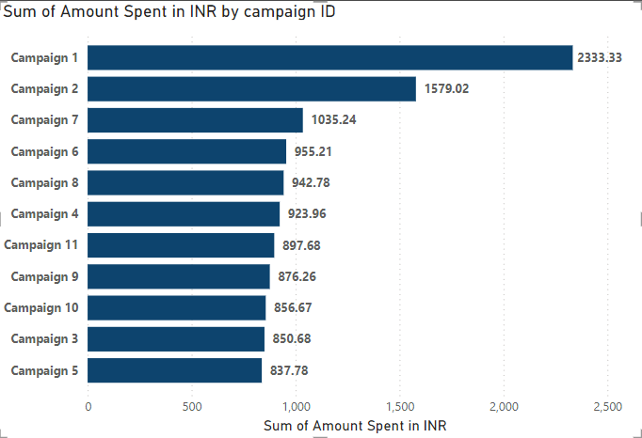
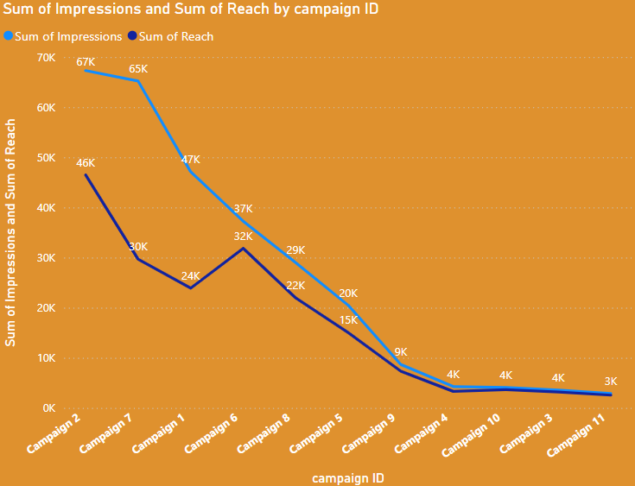
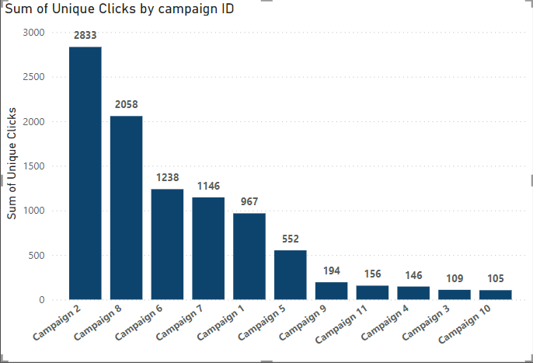
Highest Expenditure: Campaign 1.
Lowest Expenditure: Campaign 5
Most Unique Clicks: Campaign 2.
Least Unique Clicks: Campaign 10.
Impressions and Reach
Both metrics start high for Campaign 2 and decline towards Campaign 9.
FACEBOOK
MARKETING CAMPAIGN
Campaign 1-11
General overview

Slide 6
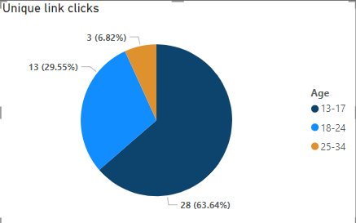



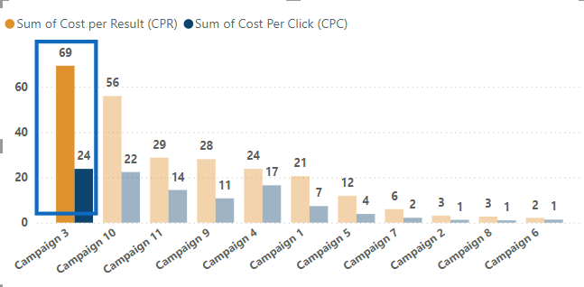
Campaign 3 should be discontinued due to its poor performance metrics:
High Costs: The cost per click (CPC) is significantly higher than the average CPC (₹24).
Low Engagement: The click-through rate (CTR) is only 1.50% , indicating low audience engagement and also below average.
Inefficiency: The campaign is not cost-effective, with high expenses and minimal returns as seen in the above average CPR (₹69).
sad
TOTAL CAMPAIGNS KPI’S
Average Click through rate(CTR)- 1.50%
Campaign 3
Faceboo
Overview (Discontinue)
CPC
AVERAGE CPC
₹3.18
1.5 out of 100 people
CTR
CTR
AVERAGE CPC
₹2.82
CPR
AVERAGE CPC
₹7.64

Slide 7
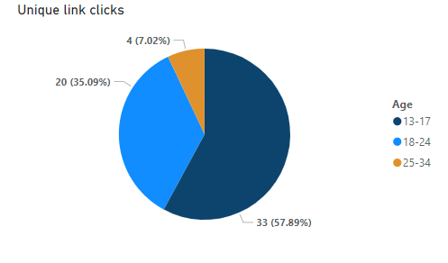
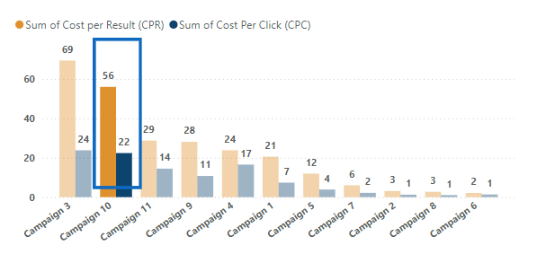
Campaign 10 should be discontinued due to its poor performance metrics:
High Costs: The cost per click (CPC) is significantly higher than the average CPC (₹22).
Low Engagement: The click-through rate (CTR) is only 1.72% , indicating low audience engagement and also below average.
Inefficiency: The campaign is not cost-effective, with high expenses and minimal returns as seen in the above average CPR (₹56) .
sad
TOTAL CAMPAIGNS KPI’S
Average Click through rate(CTR)- 1.72%
Campaign 10
Faceboo
Overview (Discontinue)
CPC
AVERAGE CPC
₹3.18
1.7 out of 100 people
CTR
CTR
AVERAGE CPC
₹2.82
CPR
AVERAGE CPC
₹7.64

Slide 8
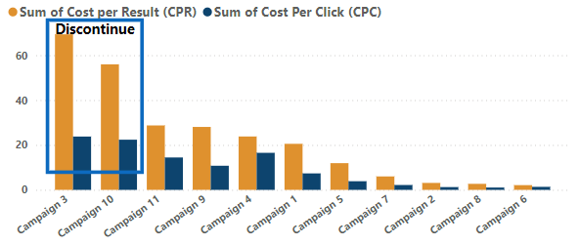
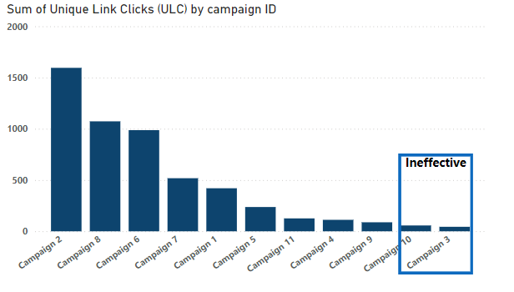
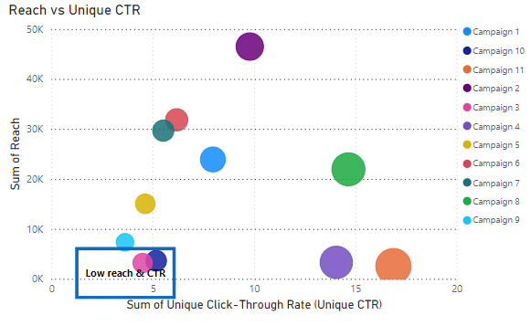
Although some other campaigns performed poorly compared to the average KPIs, more work and review can be done to optimize them.
However, Campaign 3 and Campaign 10 should be stopped because they have low reach, low click-through rates (CTR), and high costs.
Discontinuing these campaigns could improve your overall marketing strategy and reduce costs.
TOTAL CAMPAIGNS KPI’S
CONCLUSION
Faceboo
CPC
AVERAGE CPC
₹3.18
CTR
AVERAGE CPC
₹2.82
CPR
AVERAGE CPC
₹7.64

Slide 9
THANK YOU

